Slide 1
Swarm of Drones for Surveillance and Rescue Operations
Presented by:
Bhumil Rajnikant Depani
Vandit Jasmin Patel
Jeet Dhaval Shah
Rushabh Divyangkumar Patel
Arjun Sivakumar

Slide 2
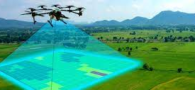
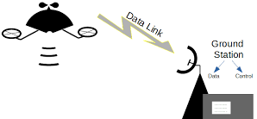
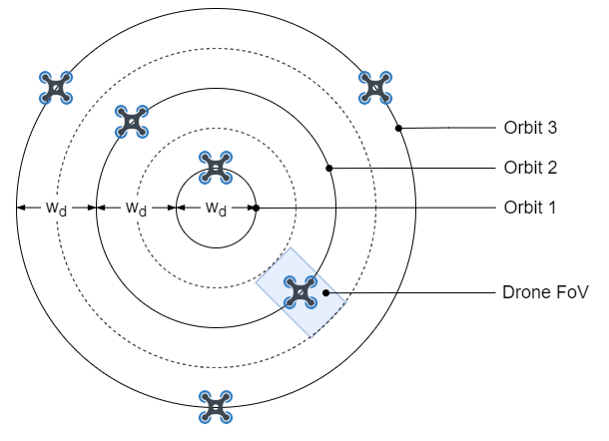
What are you trying to do?
To improve the efficiency and effectiveness of search and rescue operations
Autonomous drones equipped with cameras and other sensors
Providing Real-time information to search and rescue crews on the ground
The drones will be designed to fly in a coordinated pattern, such as a grid or spiral

Slide 3
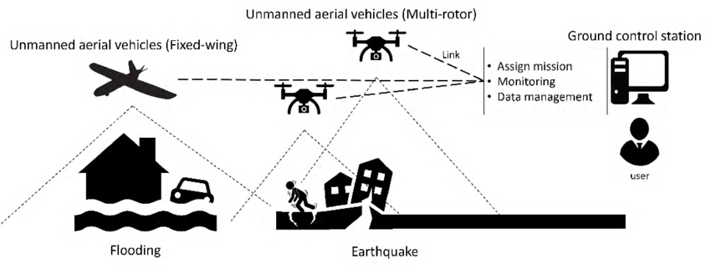
How is it done today and what are limits of current system?
Human intervention is required
Need of skilled drone operators
Synchronization between operators play a critical role
Latency of network and network might not available due to the disaster

Slide 4
What's new in your approach and why it be successful?
Fully Autonomous
Swarm-based approach to drone surveillance.
We can increase the efficiency of the battery by implementing hop-by-hop communication between the swarm and ground control.
One master-many slave architecture.
Key to success:
Mobility gives them an edge over fixed infrastructure.
Provides real-time information to search and rescue teams and cover large areas quickly and effectively.
Making it autonomous, leads to less human error

Slide 5
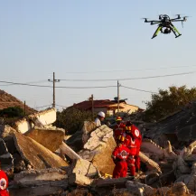
Who cares? If successful, what difference will it make?
The utilization of autonomous drones for search and rescue can significantly affect the following:
Affected community, missing people and their families
Governments and authorities responsible for emergency response
If successful, the implementation of this technology of swarm of drones has the potential to make a positive impact by:
Improving the efficiency and effectiveness of search and rescue operations.
Ensuring that no area is left unsearched
Transmission of real-time video and sensor data so that informed decisions can be made
Minimizing the risk of hazardous accidents to human rescuers.

Slide 6
Risks and payoffs
Risks:
Cybersecurity.
Technical Malfunction.
Misuse of technology.
Limited Flight Time
Payoffs:
Enhanced Situational Awareness
Cost-Effective
Rapid Response
Flexibility

Slide 7
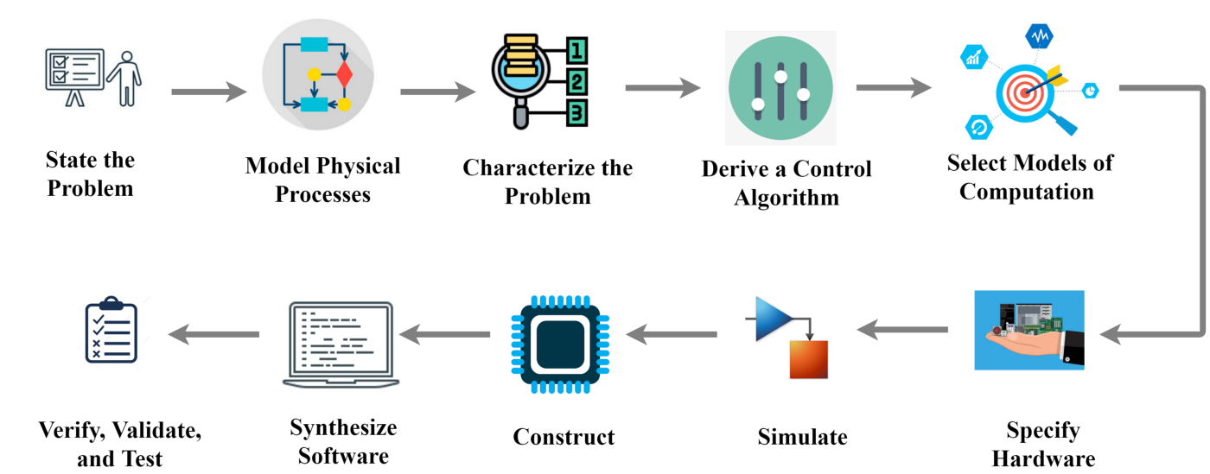
Model Based Design: Model Physical Processes
Aerodynamics: Drones rely on aerodynamics to stay airborne and maneuver through the air.
Navigation: Drones rely on GPS and other navigation systems to determine their location, altitude, and speed. These systems use sensors such as accelerometers, gyroscopes, and magnetometers to measure the drone's movement and orientation in space.
light control: In order to take off, fly and land safely, we need control of thrust, lift, and drag, attitude, heading, and altitude.
Localization and mapping: Drones must be able to accurately determine their own position and orientation, and create detailed map of the environment which involves sensors such as GPS, accelerometers, gyroscopes, and cameras.
Sensor data collection: Drones must be able to collect data from sensors such as cameras, LiDAR,etc.
Energy and power management: Drones require energy to operate, and must manage their power consumption to maximize their flight time and performance. This includes monitoring battery levels, optimizing flight paths.

Slide 8
Model Based Design: Characterize the Problem
The Environment
Complex physical processes
Communication and coordination
Mission Requirements
Performance Metrics
Energy and power management
Notes:
Here, characterizing the problem typically involves identifying the key requirements, constraints, and objectives of the system.
The environment: The type of environment the swarm will operate in, such as indoor, outdoor, urban, or rural, and the potential challenges that could be encountered, such as obstacles, wind, weather conditions, and electromagnetic interference.
Complex physical processes: The behavior of individual drones in the swarm is governed by physical laws and principles, such as movement, navigation, and control. These processes can be complex and require sophisticated algorithms and models to manage effectively. These include the physical constraints of the drones, such as their maximum speed and range.
Communication and Coordination: The communication network that will be used to enable the drones to share data and coordinate their actions, such as a wireless mesh network or a cellular network.
Mission Requirements: The mission requirements: The specific objectives of the mission, such as the area to be covered, the duration of the mission, and the targets to be detected or tracked.
Performance Metrics: The performance metrics that will be used to evaluate the effectiveness of the swarm, such as the accuracy of target detection, the time to complete the mission, and the reliability of the system.
Energy and power management: The drones in the swarm are limited by their battery capacity and need to manage their power consumption in order to maximize their flight time and performance. This requires optimization of flight paths and other strategies to minimize energy consumption.
Once the problem has been characterized, the next step in the MBD approach is to develop a model of the CPS that will enable the system to be designed, simulated, and tested before it is deployed in the real world.

Slide 9
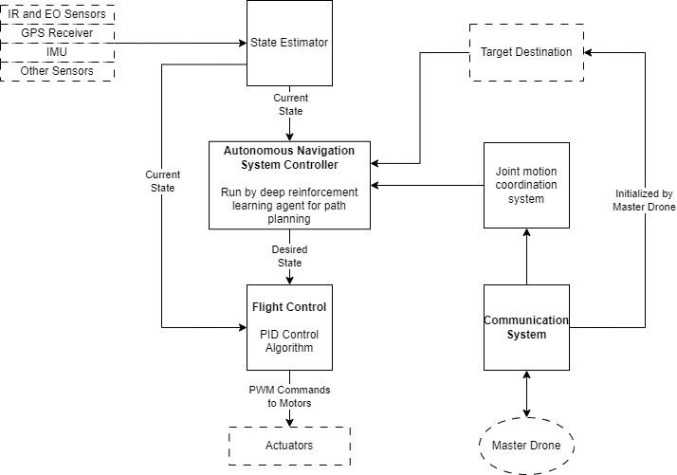
System Flow
Diagram:

Slide 10
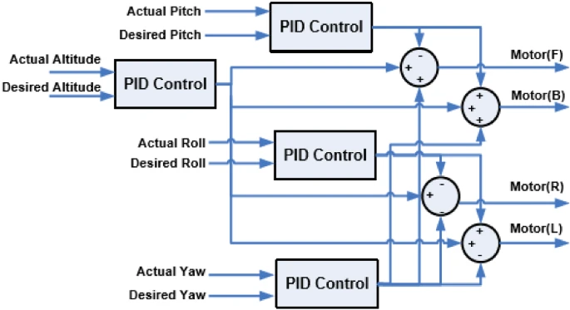
Flight Control Refinement:

Slide 11
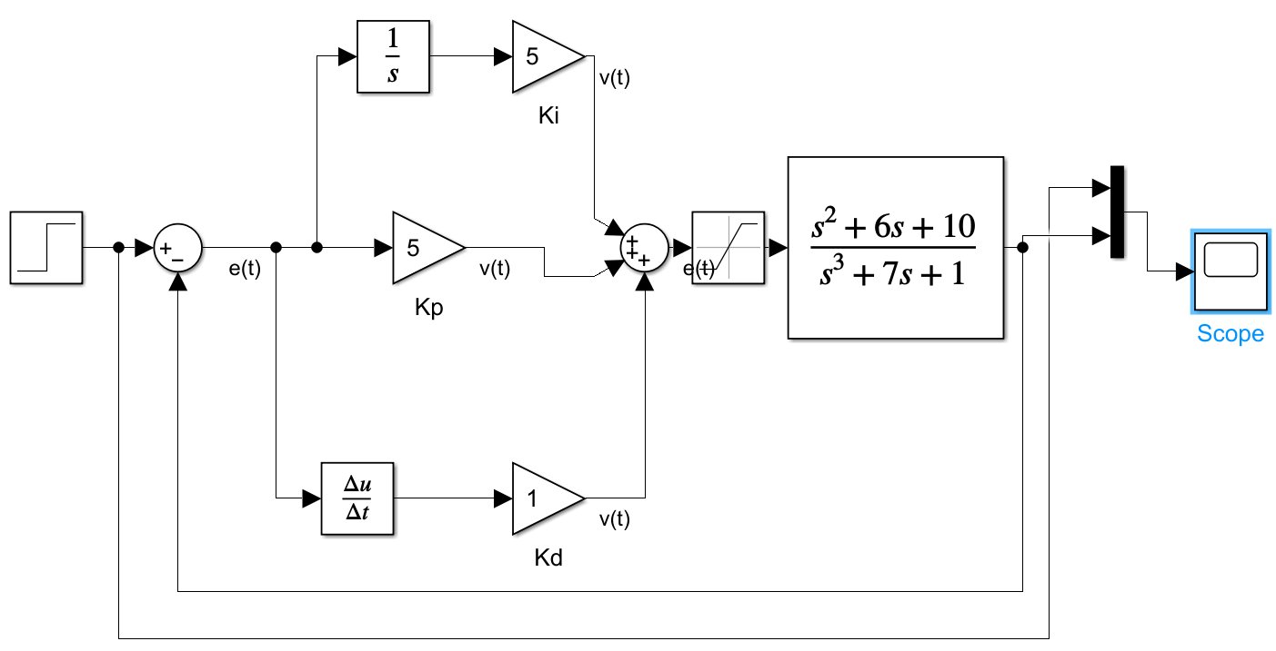
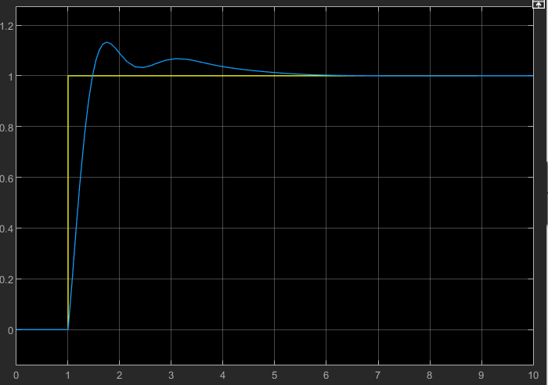
PID Implementation

Slide 12
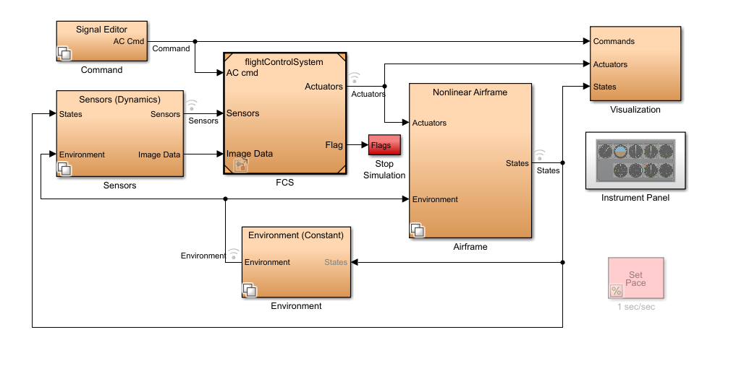
High level Control Algorithm

Slide 13
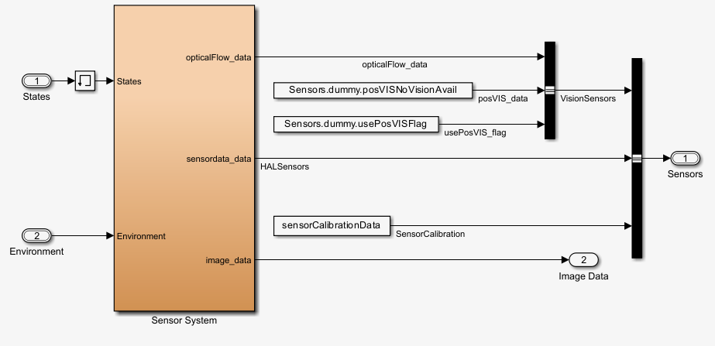
Sensor Subsystem

Slide 14
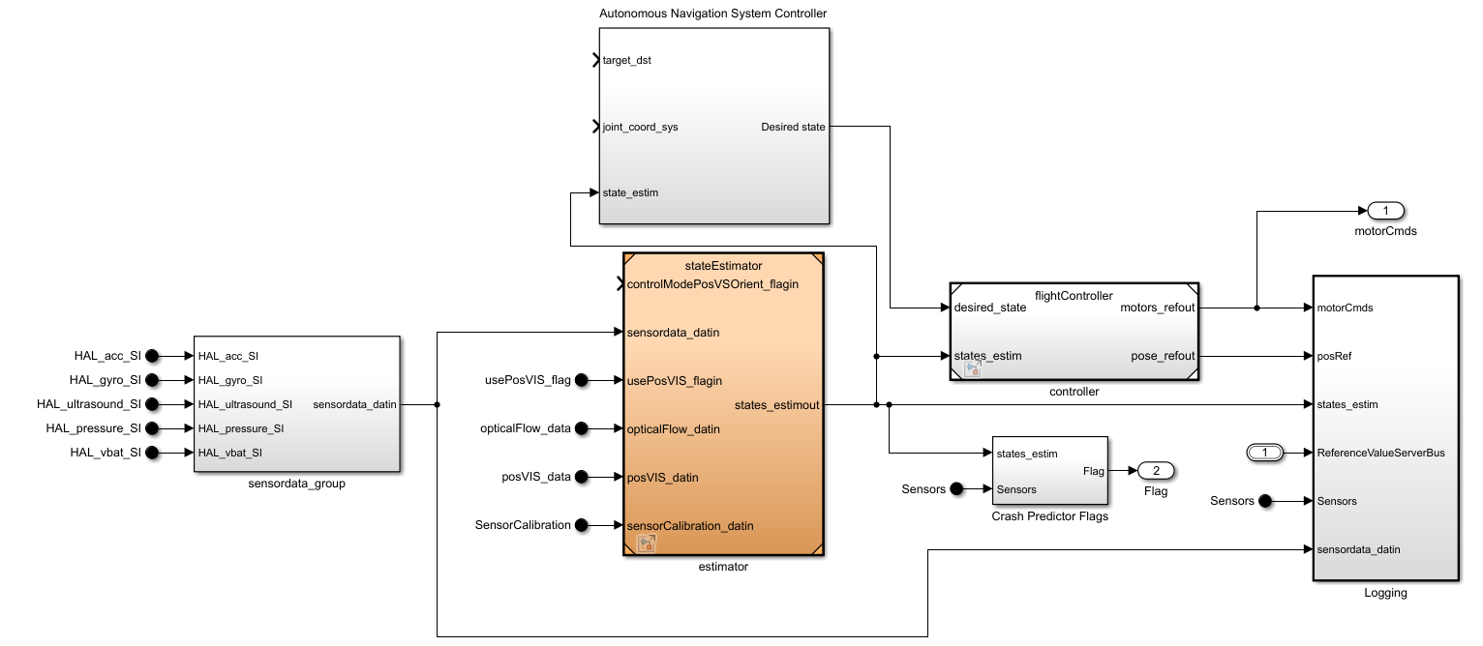
Autonomous Navigation System and Flight Control System

Slide 15
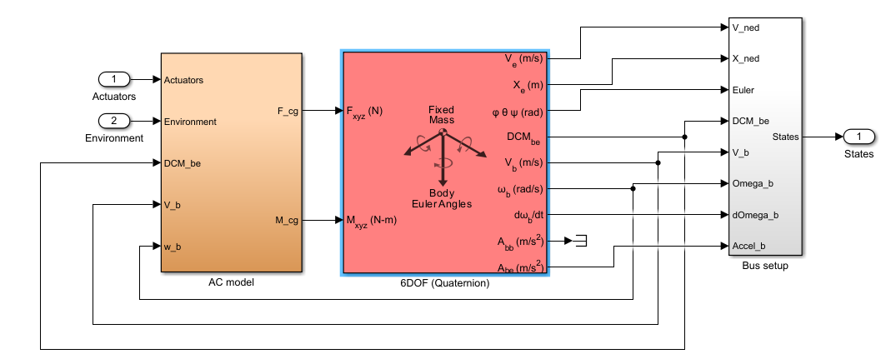
Nonlinear Airframe

Slide 16
Communication Protocol
Reliable communication
Low latency
Secure communication
Scalability
Decentralized communication

Slide 17
Selecting a Communication Protocol
The optimal protocol for this project should support
Multi-hop communication
Ad-hoc networking
Prioritization
Robustness
Bandwidth optimization
No protocol supports all 5.
That’s why we selected MAVlink for this particular project

Slide 18
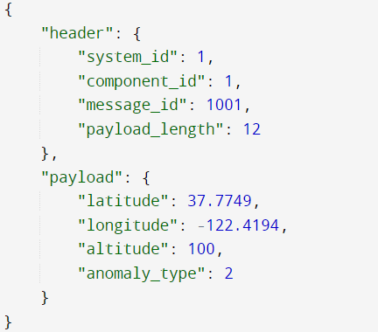
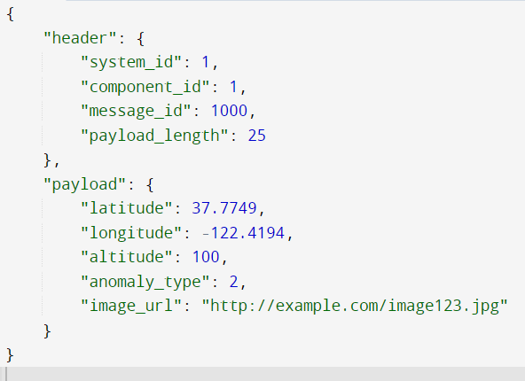
Sample Messages
Anomaly detected message to ground crew
Anomaly detected message to swarm of micro-drones

Slide 19
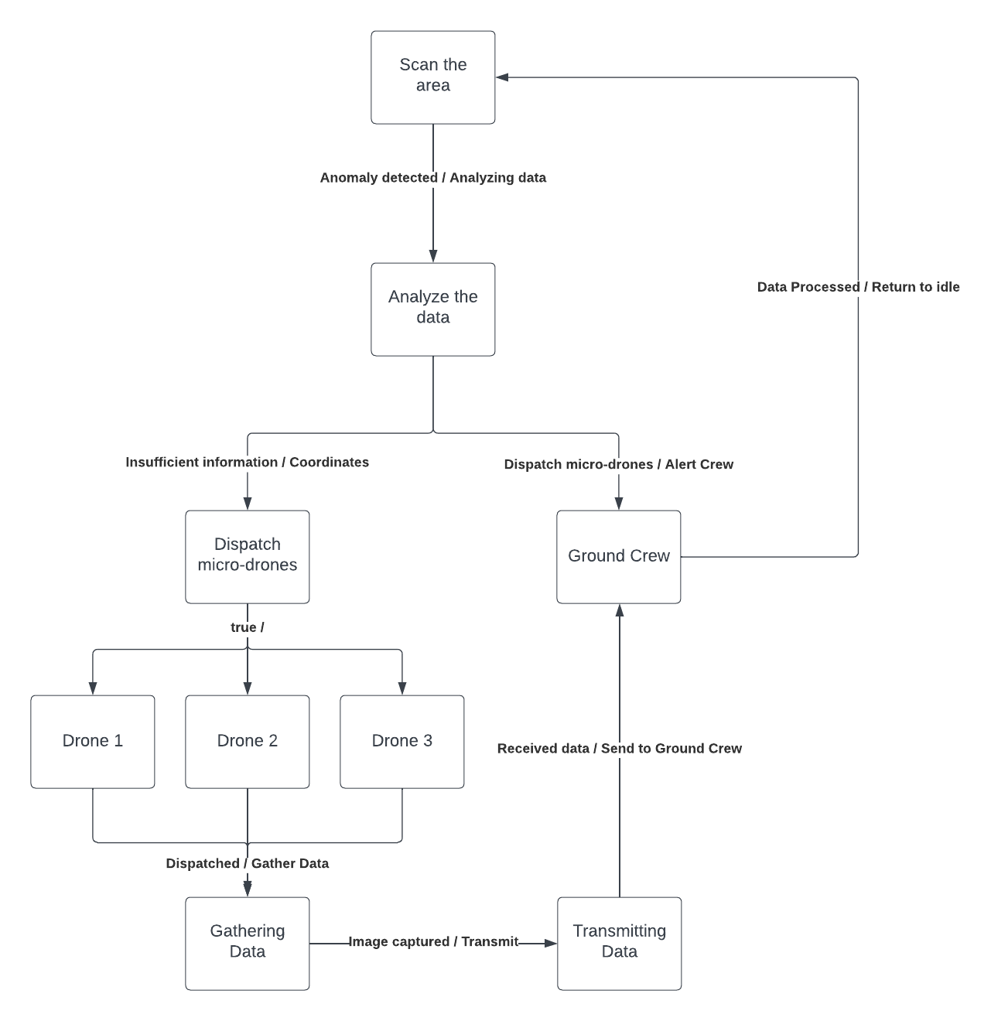
Flow of data

Slide 20
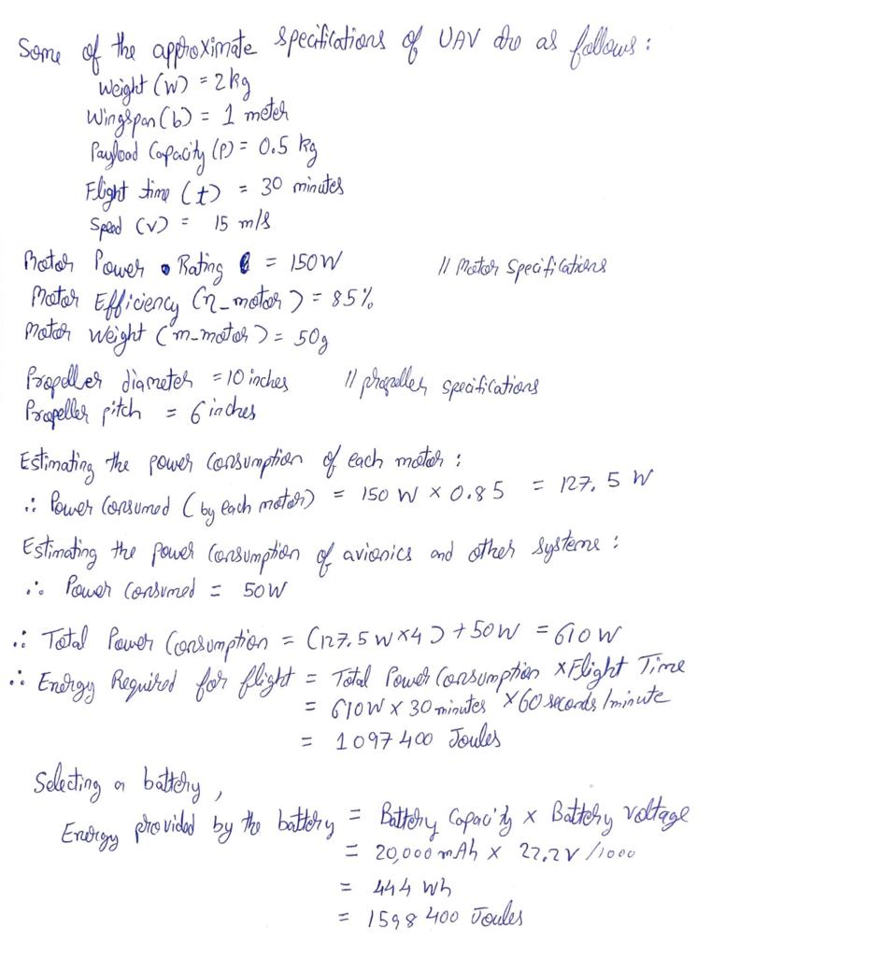
Energy and Power Usage Approximations:

Slide 21
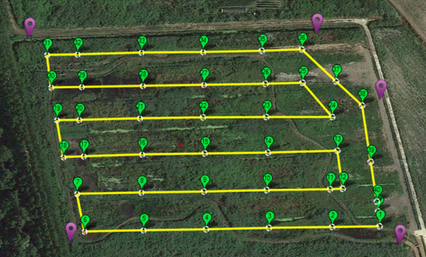
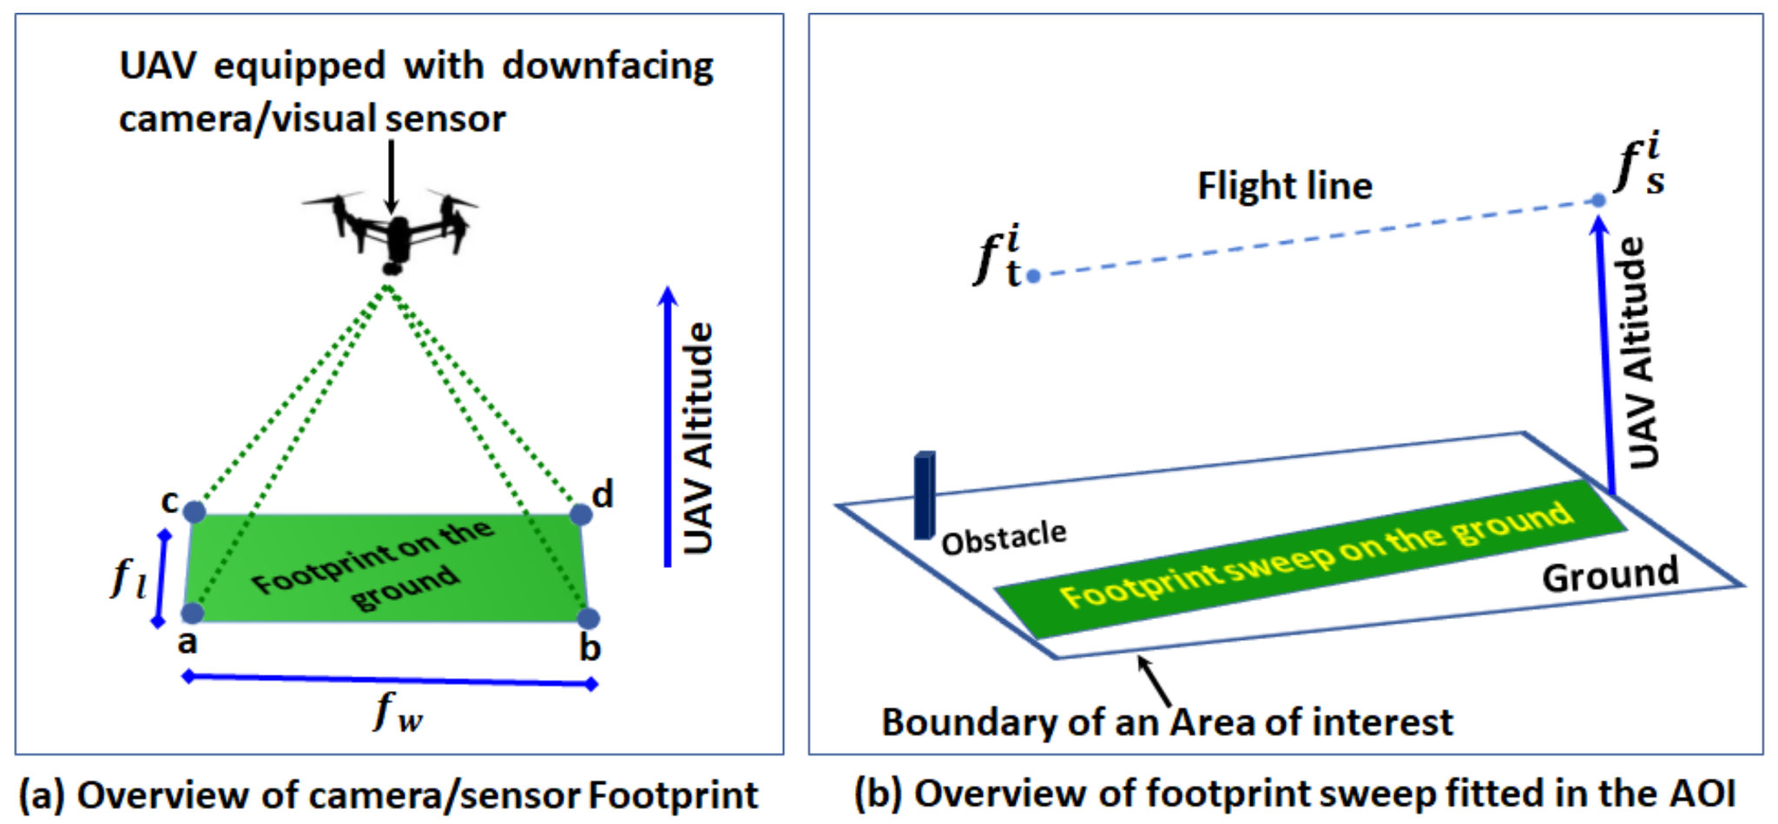
Coverage Path Planning

Slide 22
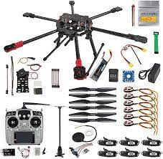
Hardware
Nvidia Jetson Nano
PixHawk Cube Flight controller
Power Distribution Board
Pixhawk GPS module
High Power DC Brushless motor
TGY-IA6B Radio Receiver
Hexacopter frame / propellers
Battery - Zeee 6S 22.2V 20000mAh LiPo Battery

Slide 23
Simulation Video
https://drive.google.com/file/d/1YxKT04v0Re5V4PFuUcP9ZtPgQA0m16N8/view?usp=share_link

Slide 24
Thank you !
Q & A

